Slide 1

Diabetes Classification
CS 513 C - Knowledge Discovery & Data Mining
Group #2
Milan Chandiramani,
Suraj Gangwani,
Lilli Nappi,
Komal Wavhal

Slide 2





Team Members
Milan G Chandiramani
CWID: 20032010
Suraj Gangwani
CWID: 20031820
Lilli Nappi
CWID: 20006502
Komal Wavhal
CWID: 20034443

Slide 3
Agenda
 |  | 1. | Introduction & Problem Statement
 |  | 2. | Project Process Flow
 |  | 3. | Dataset Review, Data Cleaning & Pre-processing
 |  | 4. | Exploratory Data Analysis
 |  | 5. | Model Overview
 |  | 6. | Comparison & Conclusion
 |  | 7. | Future Work
 |  | 8. | References
 |  | 9. | Q&As

Slide 4

Introduction & Problem Statement
Problem Statement: Diabetes, a prevalent chronic disease, affects millions of people worldwide and is linked to severe complications such as heart disease, vision loss, and kidney failure. Early detection of diabetes can significantly improve treatment outcomes and reduce healthcare costs. This problem can be addressed by developing predictive models to identify individuals at risk of developing diabetes or prediabetes.
Goal: To create a Classification machine learning model that can accurately classify individuals into 2 categories:
Those at risk of diabetes (Prediabetes or diabetes) &
Those who are not at the risk of diabetes
Such models would support early diagnosis, allowing for timely interventions to manage and potentially prevent the disease.
Dataset:
The dataset from the CDC’s Behavioral Risk Factor Surveillance System (BRFSS) for 2015 contains responses from 70,692 individuals, equally split between those with diabetes or prediabetes (class 1) and those without (class 0).
The dataset includes 21 feature variables related to health behaviors and conditions, providing an opportunity to build a classification model to predict diabetes risk.
Link: https://www.kaggle.com/datasets/alexteboul/diabetes-health-indicators-dataset/data

Slide 5




Project Process Flow
Model Selections
Problem Defination
Data Load
Data Cleaning & Pre-processing
Exploratory Data Analysis
Model Training
Model Prediction
Future Scope
Model Deployment
Hyperparameter Tuning (ANN)
Model Evaluation

Slide 6
Dataset Review
# | Column_Names | Values & Description
1 | Diabetes_binary | Ever told you have Diabetes? 0 = No; 1 = Yes Prediabtes or Diabetes
2 | HighBP | 0 = No High Blood Pressure; 1 = High Blood Pressure
3 | HighChol | 0 = No High Cholesterol; 1 = High Cholesterol
4 | CholCheck | 0 = No Cholesterol Check in 5 years; 1 = Yes Cholesterol Check in 5 years
5 | BMI | Body Mass Index
6 | Smoker | Have smoked 100 cigarettes in entire life? 0 = No 1 = Yes
7 | Stroke | Ever Told You Had a Stroke? 0 = No 1 = Yes
8 | HeartDiseaseorAttack | Have ever had a heart disease or heart attack? 0 = No 1 = Yes
9 | PhysActivity | Physical Activity in Past 30 Days (not including job) 0 = No 1 = Yes
10 | Fruits | Consumed Fruit 1 or More Times Per Day 0 = No 1 = Yes
11 | Veggies | Consumed Vegetables 1 or More Times Per Day 0 = No 1 = Yes
12 | HvyAlcoholConsump | Adult Men >= 14 drinks per week Adult Women >= 7 drinks per week 0 = No 1 = Yes
13 | AnyHealthcare | Have any kind of healthcare coverage? 0 = No 1 = Yes
# | Column_Names | Values & Description
15 | NoDocbcCost | Any time in past 12 months needed a doctor but could not go because of cost? 0 = No 1 = Yes
16 | GenHlth | Would you say that in general your health is: 1 = Excellent 2 = Very Good 3 = Good 4 = Fair 5 = Poor
17 | DiffWalk | Have serious difficulty walking or climbing stairs 0 = No 1 = Yes
18 | Sex | 0 = Female 1 = Male
19 | Age | Scale 1-13 1 = 18-24 Increments every 5 years 13 = 80+
20 | Education | Highest Grade or Year of School Completed 1 = Never Attended / Only Kindergarten 2 = Elementary 3 = Some Highschool 4 = Graduated Highschool 5 = Some College 6 = Graduated College
21 | Income | Scale 1-8 Increment every $5k 1 = less than $10,000 5 = $20,000 - $35,000 8 = $75,000+
22 | MentHlth | Days of Poor Mental Health 1-30 days
23 | PhysHlth | Physical Illness or Injury In Past 30 days 1-30 days

Slide 7
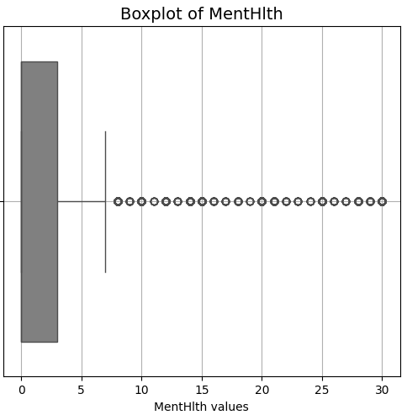
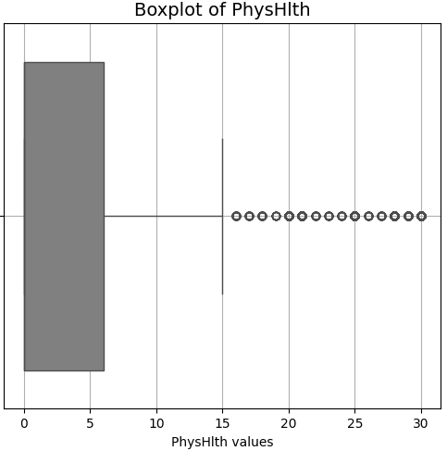
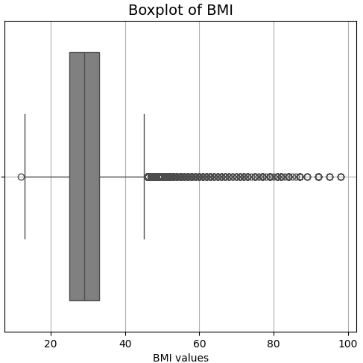
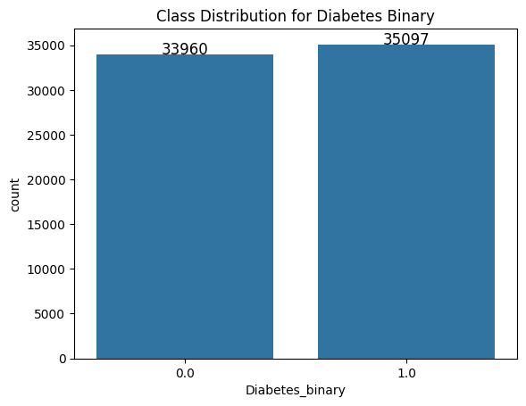
Data Cleaning & Pre-Processing
Missing Values: No missing values observed.
Duplicates: 1635 duplicate records were observed & removed.
Outliers: Based on the Box Plot, outliers were observed for features 'PhysHlth', 'MentHlth', 'BMI’ and were reduced.
Data Type: All were numerical data types (float64) bit. No Categorical data types present.
Feature Scaling: Standard scalar
Balanced Class: the diabetes_binary classes were balanced in nature with very minor difference after removing duplicates and outliers.
GitHub Link: https://github.com/wavhalkomal/Classification-algorithm-for-dietetics-dataset-
Notes:
Pandas for data cleaning
A boxplot (also known as a box-and-whisker plot) is a powerful visualization tool that is commonly used in machine learning and data analysis for understanding the distribution, spread, and outliers of numerical data. In the context of machine learning, boxplots have several important uses:
Reduced outlier by - quantile(0.25) in pandas
# Calculate the 1st (Q1) and 3rd (Q3) quartiles
Q1 = df_cleaned[column].quantile(0.25)
Q3 = df_cleaned[column].quantile(0.75)
IQR = Q3 - Q1 # Interquartile Range
# Calculate the outlier bounds
lower_bound = Q1 - multiplier * IQR
upper_bound = Q3 + multiplier * IQR
Exploratory Data Analysis (EDA)
Distribution Understanding: Boxplots provide a concise summary of the distribution of a feature. They display the median, quartiles, and the range of the data. This can help in understanding whether a feature is skewed, symmetric, or has a bimodal distribution.
Identifying Outliers: Boxplots are great for spotting outliers. Any data points that lie outside the "whiskers" of the plot (typically 1.5 times the interquartile range) are considered outliers. Identifying outliers early in your EDA helps in deciding whether to remove, transform, or investigate those outliers further.
Comparing Features: When comparing multiple features or variables, a boxplot can help in comparing the distribution of values across different categories, groups, or classes. For example, comparing feature distributions between two or more classes in a classification task.
Preprocessing and Feature Engineering
Outlier Detection: Outliers can often skew the results of machine learning models. Boxplots help to detect them, which can lead to decisions about whether to remove, cap, or transform those values.
Feature Transformation: If a feature’s distribution is highly skewed, you may decide to transform it (e.g., using logarithmic or square root transformations) before feeding it into a model. A boxplot can help visually identify such skewness.
Detecting Multimodal Distributions: A boxplot can also suggest if a feature has multiple modes (peaks), indicating that the feature might benefit from further transformation or discretization.
Model Performance Evaluation
Comparison Across Models: Boxplots can be used to compare the performance of different machine learning models across multiple runs. For example, comparing the cross-validation scores or the accuracy of multiple algorithms in a boxplot can give insights into the variability of model performance, helping identify the model that consistently performs best.
Error Analysis: After building a model, boxplots can help in analyzing the residuals (errors) of a model. By plotting the residuals using boxplots, you can identify any patterns, potential outliers, or biases that may indicate issues with model assumptions.
Checking for Class Imbalance
In classification problems, especially when dealing with imbalanced datasets, boxplots can be used to compare the distributions of numerical features across different classes. If one class is heavily skewed or has distinct characteristics, this may indicate that data preprocessing (like oversampling, undersampling, or class weighting) is required.
Visualizing Data Relationships
Categorical vs. Continuous Variables: Boxplots are particularly useful for visualizing the relationship between categorical and continuous variables. For example, in a classification problem, you might use boxplots to visualize how the distributions of a feature differ for each class.
Group Comparisons: In a dataset with multiple groups or categories, boxplots can show how each group’s distribution compares to the others. This can be useful in understanding how different subgroups behave or how different features affect the target variable.
Feature Scaling:
Feature scaling refers to the process of normalizing or standardizing the range of independent variables (features) in a dataset. Machine learning algorithms often perform better or converge faster when the features are on a similar scale, especially those that use distance-based calculations (e.g., K-Nearest Neighbors (KNN), Support Vector Machines (SVM), Linear Regression, and Neural Networks).
Why is Feature Scaling Important?
Improved Performance: Many machine learning models assume or perform better when the data is on a similar scale. Without scaling, features with larger ranges or magnitudes can dominate the learning process and bias the results.
Faster Convergence: Some optimization algorithms (e.g., gradient descent) converge more quickly when the features are scaled properly.
Distance-Based Algorithms: Algorithms like KNN, SVM, and clustering algorithms rely on the distance between points. If one feature is much larger than others, it will disproportionately affect the distance calculation.
StandardScaler in Python (using scikit-learn)
import seaborn as sns
import matplotlib.pyplot as plt
# Check the distribution of the target variable
print(df['Diabetes_binary'].value_counts())
# Create the countplot for the target variable
ax = sns.countplot(x='Diabetes_binary', data=df)
# Title of the plot
plt.title('Class Distribution for Diabetes Binary')
# Add the value labels on top of the bars
for p in ax.patches:
height = p.get_height() # Get the height of each bar
ax.text(p.get_x() + p.get_width() / 2., height + 5, # Position the text slightly above the bar
int(height), # The actual value (height of the bar)
ha="center", # Horizontal alignment
fontsize=12, # Font size
color='black') # Text color
# Show the plot
plt.show()

Slide 8
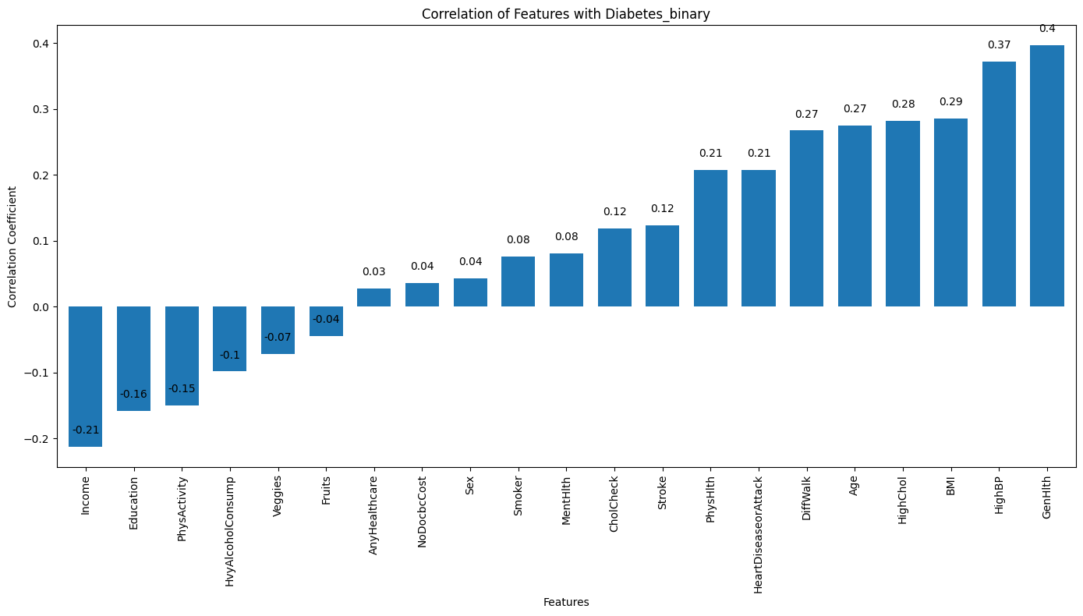
Exploratory Data Analysis (1 of 3)
Correlation Coefficients: The chart displays the correlation coefficient between each input feature and the ‘Diabetes_Binary’ target variable. The correlation coefficient measures the strength and direction of the linear relationship between two variables.
Positive Correlation: Features like ‘Age’, ‘HighChol’, ‘HighBP’, ‘BMI’, and ‘GenHlth’ show a positive correlation with “Diabetes_Binary”. This suggests that as these features increase, the likelihood of having diabetes also tends to increase.
Negative Correlation: Features like ‘Income’, ‘Education’, ‘PhysActivity’, and ‘HvyAlcoholConsump’ exhibit a negative correlation with ‘Diabetes_Binary’.
This implies that individuals with higher income, education, and physical activity levels, and lower heavy alcohol consumption, are less likely to have diabetes.
Weak Correlation: Many features, such as ‘Veggies’, ‘Fruits’, ‘AnyHealthcare’, ‘NoDocbcCost’, ‘Sex’, and ‘Smoker’, show a very weak correlation with ‘Diabetes_Binary’. This indicates that these features might have limited predictive power for diabetes in this dataset
Insights:
Risk Factors: The chart highlights potential risk factors for diabetes, such as older age, high cholesterol, high blood pressure, and poor general health.
Protective Factors: Features like higher income, education, and physical activity appear to be associated with a lower risk of diabetes.
Feature Importance: Features with stronger correlations (positive or negative) are likely to be more important for predicting diabetes in a machine learning model.
Notes:
Implemented bar plot - for correlation values
import matplotlib.pyplot as plt
# Assuming df.corr()['Diabetes_binary'] is already computed
# Create the bar plot for the correlation values
ax = df.corr()['Diabetes_binary'][1:].sort_values().plot(kind='bar', figsize=(14, 8), width=0.7)
# Add values on top of each bar
for p in ax.patches:
height = p.get_height() # Get the height of each bar
ax.text(p.get_x() + p.get_width() / 2., height + 0.02, # Position text slightly above the bar
round(height, 2), # Round the value for better readability
ha="center", # Horizontal alignment
fontsize=10, # Font size for the value labels
color='black') # Text color
# Title and labels
plt.title('Correlation of Features with Diabetes_binary', fontsize=12)
plt.ylabel('Correlation Coefficient', fontsize=10)
plt.xlabel('Features', fontsize=10)
# Adjust layout to prevent unnecessary padding and maximize space
plt.tight_layout()
# Display the plot
plt.show()

Slide 9
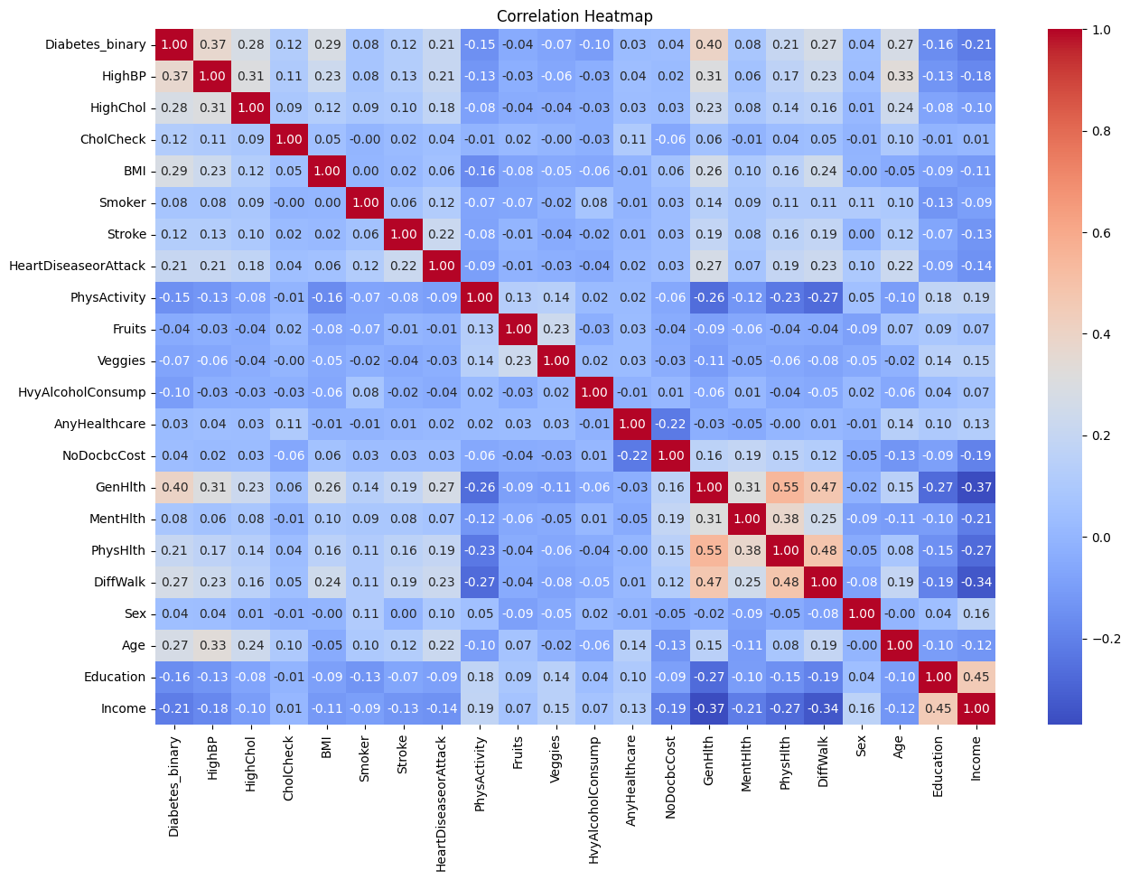
Exploratory Data Analysis (2 of 3)
A correlation heatmap is a data visualization tool used to display the correlation matrix of a dataset.
Correlation Coefficients:
The values in the heatmap represent the correlation coefficients between pairs of variables. Correlation coefficients typically range from -1 to +1:
+1 indicates a perfect positive linear relationship (as one variable increases, the other also increases).
-1 indicates a perfect negative linear relationship (as one variable increases, the other decreases).
0 indicates no linear relationship.
Color Gradient:
The heatmap uses color to represent these correlation coefficients. For example, darker colors might represent stronger correlations (either positive or negative), and lighter colors could indicate weaker or no correlation.
Dark blue: represent strong negative correlations (close to -1).
Light blue: represent weak or no correlation (around 0).
Dark red: represent strong positive correlations (close to +1).
Strong Positive Correlations with Diabetes_Binary:
BMI: 0.29 - A strong positive correlation indicates that the risk of diabetes increases significantly with increase in BMI.
Moderate Positive Correlations with Diabetes_Binary:
HeartDiseaseorAttack: 0.21 - A moderate positive correlation suggests a link between heart disease and diabetes.
Education: -0.16 - A negative correlation suggests that higher education is associated with a lower risk of diabetes.
Income: -0.21 - A negative correlation suggests that higher income is associated with a lower risk of diabetes.
Other Observations:
Smoking & Alcohol Consumption: The correlations with smoking (0.04) and alcohol consumption (0.01) are very weak, indicating that these factors might not be as strongly associated with diabetes in this dataset compared to other factors.
Negative Correlations with Diabetes_Binary:
HighBP (High Blood Pressure): 0.37 - A very strong positive correlation indicates a strong association between high blood pressure and diabetes.
Uses of Correlation Heatmap
Identifying Relationships Between Variables
Feature Selection
Detecting Patterns, Predictive Modeling
Outlier Detection, Visual Clarity
Correlation Heatmap
Notes:
# Compute the correlation matrix for numerical features
corr_matrix = df.corr() #Pearson correlation.
# Plot heatmap of correlations
plt.figure(figsize=(15, 10))
sns.heatmap(corr_matrix, annot=True, cmap='coolwarm', fmt='.2f')
plt.title('Correlation Heatmap')
plt.show()

Slide 10
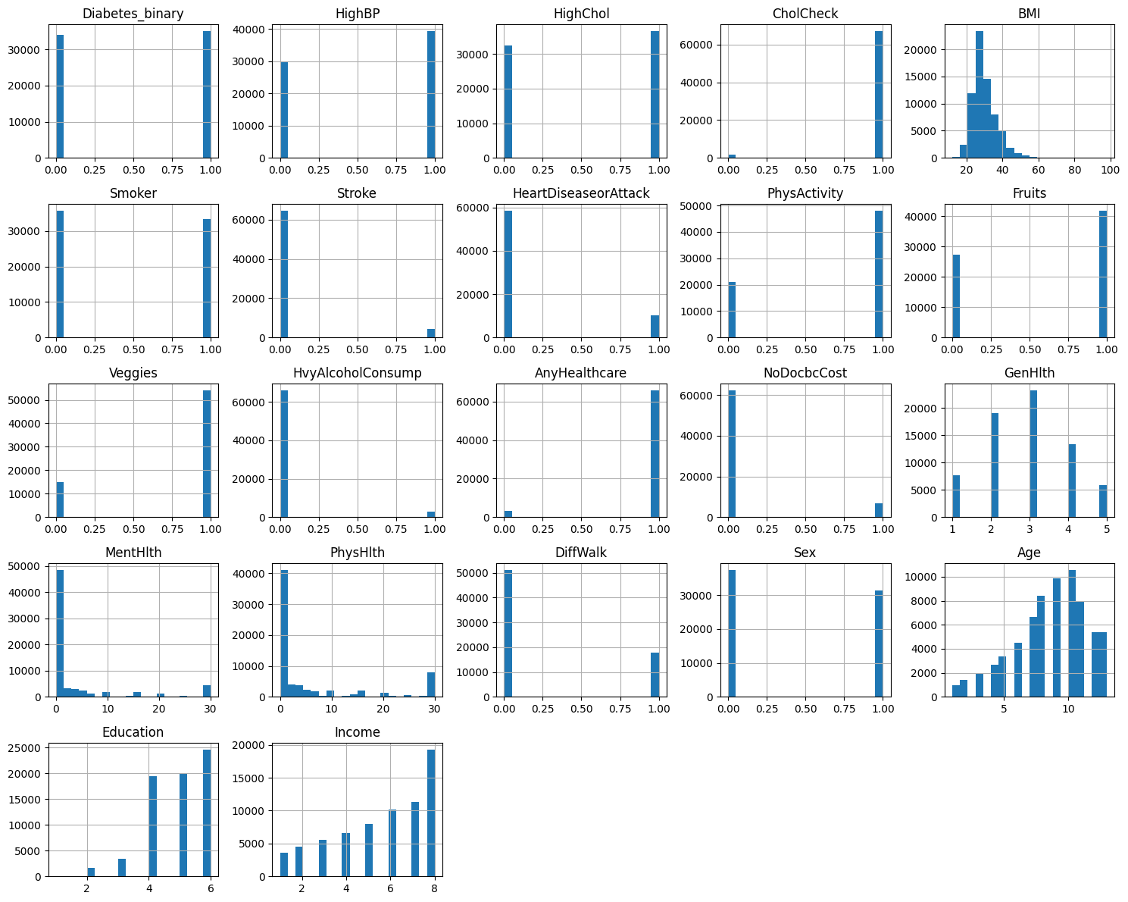
Exploratory Data Analysis (3 of 3)
A histogram is a graphical representation of the distribution of numerical data. It displays the frequency (or count) of data points within specific ranges, known as bins.
Each bar in a histogram represents the frequency or count of data points that fall within a certain range (bin) of values.
What is a Histogram?
A histogram consists of bars (or rectangles), where:
The height of each bar represents the frequency or count of data points that fall within a certain range of values (bin).
The x-axis represents the range of values, typically divided into equal intervals (bins).
The y-axis represents the frequency or count of data points within each bin.
Uses of Histograms:
1. Understanding Data Distribution
2. Identifying Skewness: Skewness refers to the asymmetry in the distribution of data. A histogram helps you identify if your data is.
Right-skewed (positively skewed): The right tail is longer or fatter. This means most data points are concentrated on the lower end.
Left-skewed (negatively skewed): The left tail is longer or fatter, meaning most data points are concentrated on the higher end.
3. Identifying Outliers: Outliers are data points that are far away from the rest of the data.
4. Visualizing the Range of Data
5. Analyzing Data Shape (Normal Distribution)
Based on the histogram analysis, the BMI is left skewed and also has few outliers above 45 plus (as confirmed by Box plot as well)
Diabetes_Binary: This is the target variable. The histogram likely shows an imbalance in the classes (more non-diabetic cases than diabetic cases), which is common in medical datasets. This imbalance needs to be addressed during model training to avoid biased results.
HighBP, HighChol, HeartDiseaseorAttack, Stroke: These features likely show a higher proportion of individuals without these conditions compared to those with.
Feature Types: We can identify the types of features: Binary: Features like Diabetes_Binary, Smoker, Stroke, etc., seem to be binary (0/1) variables.
Ordinal: Features like Education and Income likely represent ordinal categories.
Continuous: Features like Age, BMI, MentHlth, PhysHlth seem to be continuous variables.
Histogram
Notes:
df.hist(bins=20, figsize=(15, 12))
plt.tight_layout()
plt.show()
# Check for duplicate rows
df.duplicated().sum()
df.shape
# Remove duplicates if necessary
df.drop_duplicates(inplace=True)
df.shape
def load_data(file_path):
# Load the dataset
df = pd.read_csv(file_path)
print(f"Data loaded successfully! Shape: {df.shape}")
return df

Slide 11
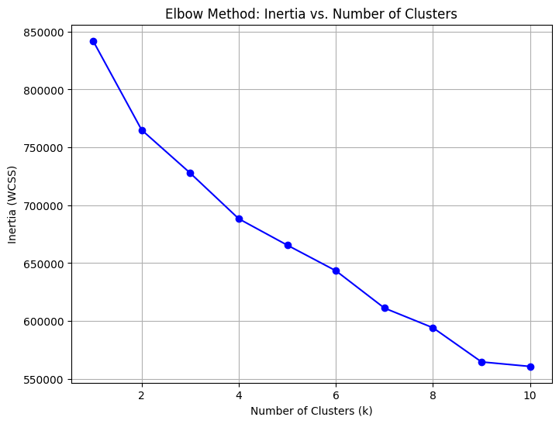
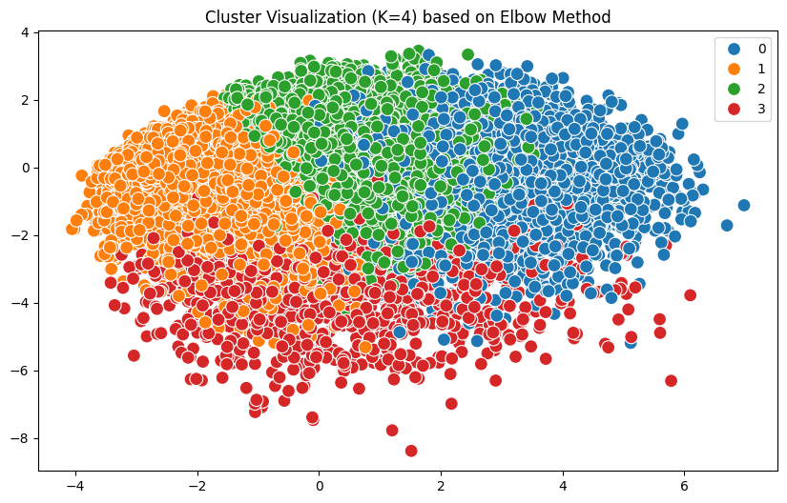
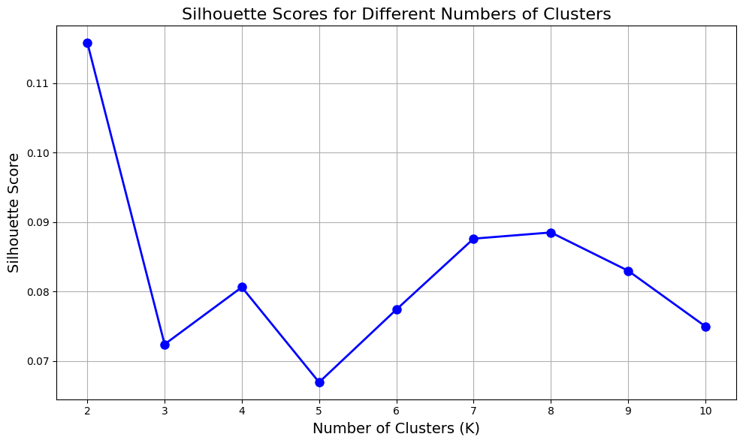
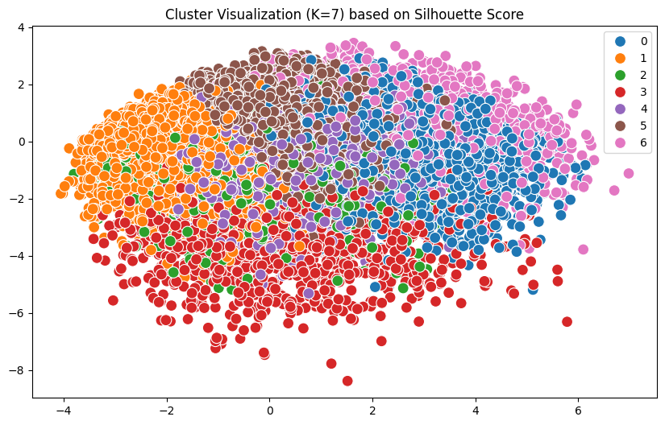
Model Overview (K-Means Clustering)
K-Means Clustering is a popular unsupervised learning algorithm used to partition a dataset into K clusters (groups) based on feature similarity. It is one of the simplest and most widely used clustering techniques.
K-Means can handle large datasets well, especially when the number of clusters KKK is relatively small.
K-means clustering, an un-supervised algorithm doesn’t work great for irregular shaped clusters as visualized for K=4 and K=7 based on Elbow method and Silhouette Scores resp.
For Elbow method:
After K = 4, the decrease in WCSS i.e. within-cluster sum of squares becomes less pronounced.
For Silhouette Scores:
The highest Silhouette Score appears to be around K=7 clusters where,
a Silhouette Score of 0.09 suggests that the clustering solution is not very strong. The clusters are likely to be weakly separated, and there may be some overlap or ambiguity in how the data is grouped.
Note: There’s no accuracy for K-means as accuracy measures how many predictions match ‘True’ labels and K-means is unsupervised so, No labels.
Notes:
from sklearn.cluster import KMeans
K-Means is one of the most popular and widely used unsupervised machine learning algorithms for clustering tasks.
Clustering is the process of grouping similar data points together into clusters based on certain features, without using any labels or predefined classes.
K-Means is a partition-based clustering method that aims to divide data into a predefined number of clusters.
K-Means clustering works by partitioning the data into K clusters (where K is a predefined number), where each data point belongs to the cluster with the nearest mean (centroid).
The goal of K-Means is to minimize the variance (or sum of squared distances) within each cluster.
1. Elbow Method:
The Elbow Method is a heuristic used to choose the optimal number of clusters (K) by plotting the within-cluster sum of squares (WCSS) for different values of K and looking for an "elbow" point in the graph.
Steps for the Elbow Method:
Fit the K-Means algorithm to the data for different values of K (e.g., from 1 to 10 or more).
Calculate the WCSS for each value of K.
Plot K (on the x-axis) vs WCSS (on the y-axis).
Look for the point where the WCSS curve starts to flatten, creating an "elbow" shape.
Choose the value of K at the "elbow" as the optimal number of clusters.
2. Silhouette Scores:
The Silhouette Score is a metric used to measure the quality of clustering. It quantifies how well each data point fits within its assigned cluster, as well as how distinct the cluster is from others.
The score ranges from -1 to 1, where:
1 indicates that the points are well-clustered, meaning they are closer to their own cluster centroid than to the centroids of other clusters.
0 means that the points are on or very close to the decision boundary between two clusters.
-1 indicates that the points may have been assigned to the wrong cluster (i.e., they are closer to a neighboring cluster than to their own cluster).
How K-Means Algorithm Works:
The K-Means algorithm follows an iterative process to find the optimal cluster assignments and centroids. Here's a high-level overview of how it works:
Initialization:
Select K initial centroids (these can be chosen randomly or using a more advanced method like K-Means++).
Assignment Step:
For each data point in the dataset, assign it to the nearest centroid. The "nearest" centroid is determined by calculating the Euclidean distance (or other distance metrics) between the data point and the centroids.
Update Step:
Once all points are assigned to clusters, calculate the new centroids for each cluster. The centroid is typically the mean (average) of all the data points assigned to that cluster.
Repeat:
Repeat the Assignment and Update steps until convergence, meaning the centroids no longer change significantly, or a certain number of iterations is reached.
Advantages of K-Means:
Simple and easy to implement: K-Means is relatively easy to understand and use.
Scalability: Works well with large datasets, especially in high-dimensional spaces.
Efficiency: It converges relatively quickly, especially if the number of clusters (K) is small.
Flexibility: Can be applied to various domains like marketing, image analysis, and bioinformatics.
Using Elbow Method:
The Elbow Method is based on the idea of finding the "elbow" in the inertia (or SSE — sum of squared errors) plot. The inertia measures how well the data fits into clusters: lower inertia indicates better clustering. The elbow is the point where adding more clusters doesn't reduce inertia significantly.
Limitations: The Elbow Method only considers how compact the clusters are (i.e., inertia), but doesn't account for how well-separated or cohesive the clusters are, which is what the Silhouette Score evaluates.
#Determining optimal number of Clusters:
import matplotlib.pyplot as plt
from sklearn.cluster import KMeans
# Create an empty list to store the inertia values (WCSS)
inertia = []
# Range of k values to test (e.g., from 1 to 10)
k_range = range(1, 11)
# Fit KMeans for each k value and compute inertia (WCSS)
for k in k_range:
kmeans = KMeans(n_clusters=k, random_state=42)
kmeans.fit(X_train) # Use X_train as your feature data
inertia.append(kmeans.inertia_)
# Plotting the elbow graph
plt.figure(figsize=(8, 6))
plt.plot(k_range, inertia, marker='o', linestyle='-', color='b')
plt.title('Elbow Method: Inertia vs. Number of Clusters')
plt.xlabel('Number of Clusters (k)')
plt.ylabel('Inertia (WCSS)')
plt.grid(True)
plt.show()

Slide 12
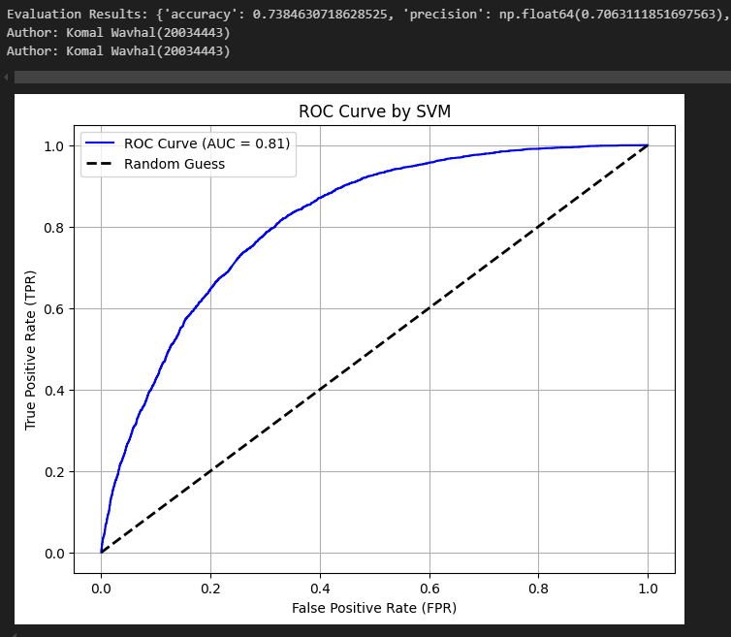
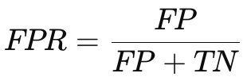
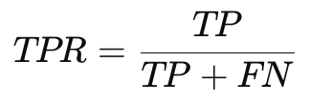
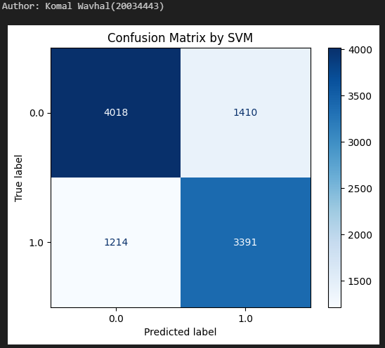
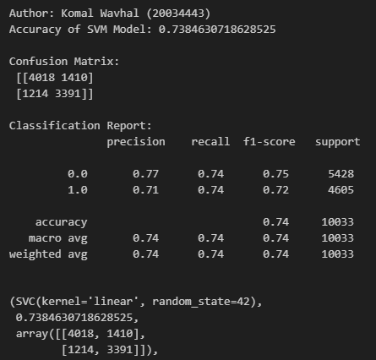
Model Overview (Support Vector Machine)
Support Vector Machine (SVM) is a supervised ML algorithm primarily used for classification, regression, and outlier detection task.
Receiver Operating Characteristic (ROC) curve is a graphical representation of a binary classifier's performance at various classification thresholds. It illustrates the trade-off between True Positive Rate (TPR) and False Positive Rate (FPR) as the decision threshold changes
ROC Curve represent:
X-axis: False Positive Rate (FPR) Incorrectly predicted positive cases
Y-axis: True Positive Rate (TPR) Correctly predicted negative cases
Curve: The ROC curve will be a vertical line starting from (0,0) and rising directly to (0,1)
Diagonal Line (Random Classifier)
Top-Left Corner (Perfect Classifier)
Performance Metrics:
Accuracy: The proportion of correctly classified instances. In this case, the accuracy is around 0.738, i.e. 73.8%.
Is important when classes are balanced, and False Positives and False Negatives carry similar consequences.
Precision: Precision measures how many of the instances predicted as positive are actually positive.
It's around 0.706 i.e. 70.6% Is important when False Positive is more critical,
Recall: Recall quantifies the proportion of actual positive instances correctly identified by the model.
It's around 0.736 i.e. 73.6% Is important when False Negatives are more critical e.g. Medical diagnosis
F1-score: The harmonic mean of precision and recall, providing a balance between the two.
It's around 0.721 i.e. 72.1% Is more important when dataset is unbalanced. However, for a nearly balanced data in our project, so, it’s not crucial here.
AUC (Area Under the ROC Curve): A measure of the model's ability to distinguish between positive and negative classes.
It's around 0.815 i.e. 81.5%
Fig: ROC Curve by SVM
AUC = 1 : Perfect classifier (model correctly classifies all positive and negative samples).
AUC = 0.5: No better than random guessing (model is not able to distinguish between classes).
AUC < 0.5: The model performs worse than random guessing (e.g., consistently predicting the wrong class).
Conclusion: AUC-ROC evaluates the model across all possible thresholds, providing a more comprehensive view of performance compared to metrics like accuracy, which depend on a specific threshold.
Confusion Matrix: A deeper insight into the performance of a classifier beyond just accuracy. Accuracy alone may not be sufficient, especially in cases where the data is imbalanced.
True Positive (TP): 3391 - The model correctly predicted the positive class (1.0) for 3391 instances.
True Negative (TN): 4018 - The model correctly predicted the negative class (0.0) for 4018 instances.
False Positive (FP): 1410 - The model incorrectly predicted the positive class (1.0) when the actual class was negative (0.0). These are also known as Type I errors.
False Negative (FN): 1214 - The model incorrectly predicted the negative class (0.0) when the actual class was positive (1.0). These are also known as Type II errors.
Fig: Confusion Matrix by SVM
Fig: Performance Metric Results
Notes:
Support Vector Machine is a supervised machine learning algorithm primarily used for classification, regression, and outlier detection task.
SVM attempts to find a hyperplane that separates data points of different classes with the maximum margin. This hyperplane is the one that has the largest distance to the nearest data points from any class (these points are called support vectors).
The Receiver Operating Characteristic (ROC) curve is a graphical representation of a binary classifier's performance at various classification thresholds, It illustrates the trade-off between True Positive Rate (TPR) and False Positive Rate (FPR)
AUC ranges from 0 to 1 and the Key Terminology in the ROC Curve are TP, TN, FP, FN
mportance and Need for the Confusion Matrix in Machine Learning
The Confusion Matrix provides a deeper insight into the performance of a classifier beyond just accuracy. Accuracy alone may not be sufficient, especially in cases where the data is imbalanced (e.g., when one class significantly outweighs the other). The confusion matrix allows us to compute more nuanced metrics that help evaluate the classifier's performance more comprehensively.
Imbalanced Datasets: If you have an imbalanced dataset (e.g., one class occurs much more frequently than the other), accuracy might be misleading. The model could predict the majority class all the time and still achieve a high accuracy, even if it performs poorly on the minority class. The confusion matrix helps highlight this by showing the number of False Positives and False Negatives.
Model Evaluation: It helps assess how well the model is doing in terms of classifying both the positive and negative instances correctly.
Error Analysis: It enables you to understand the types of errors your model is making, helping you improve the model, choose better features, or adjust thresholds for classification.
#This execution takes around 40 minutes.
import matplotlib.pyplot as plt
from sklearn.metrics import roc_curve, ConfusionMatrixDisplay, confusion_matrix
# Takes around 20 min 15 secs:
from sklearn.svm import SVC
# Initialize SVM model
svm = SVC(kernel='linear', probability=True)
# Evaluate the model
svm_results = evaluate_model(svm, X_train, X_test, y_train, y_test)
# Store the results
print("Evaluation Results:", svm_results)
# Plot ROC Curve
def plot_roc_curve(model, X_test, y_test):
y_pred_prob = model.predict_proba(X_test)[:, 1]
fpr, tpr, _ = roc_curve(y_test, y_pred_prob)
print("Author: Komal Wavhal(20034443)")
plt.figure(figsize=(8, 6))
plt.plot(fpr, tpr, color='blue', label=f"ROC Curve (AUC = {svm_results['auc']:.2f})")
plt.plot([0, 1], [0, 1], 'k--', lw=2, label="Random Guess")
plt.xlabel("False Positive Rate (FPR)")
plt.ylabel("True Positive Rate (TPR)")
print("Author: Komal Wavhal(20034443)")
plt.title("ROC Curve by SVM")
plt.legend()
plt.grid()
plt.show()
# Plot Confusion Matrix
def plot_confusion_matrix(model, X_test, y_test):
y_pred = model.predict(X_test)
cm = confusion_matrix(y_test, y_pred)
disp = ConfusionMatrixDisplay(confusion_matrix=cm, display_labels=model.classes_)
disp.plot(cmap="Blues", values_format="d")
print("Author: Komal Wavhal(20034443)")
plt.title("Confusion Matrix by SVM")
plt.show()
# Fit and Plot Results
svm.fit(X_train, y_train)
# Call plotting functions
plot_roc_curve(svm, X_test, y_test)
plot_confusion_matrix(svm, X_test, y_test)

Slide 13
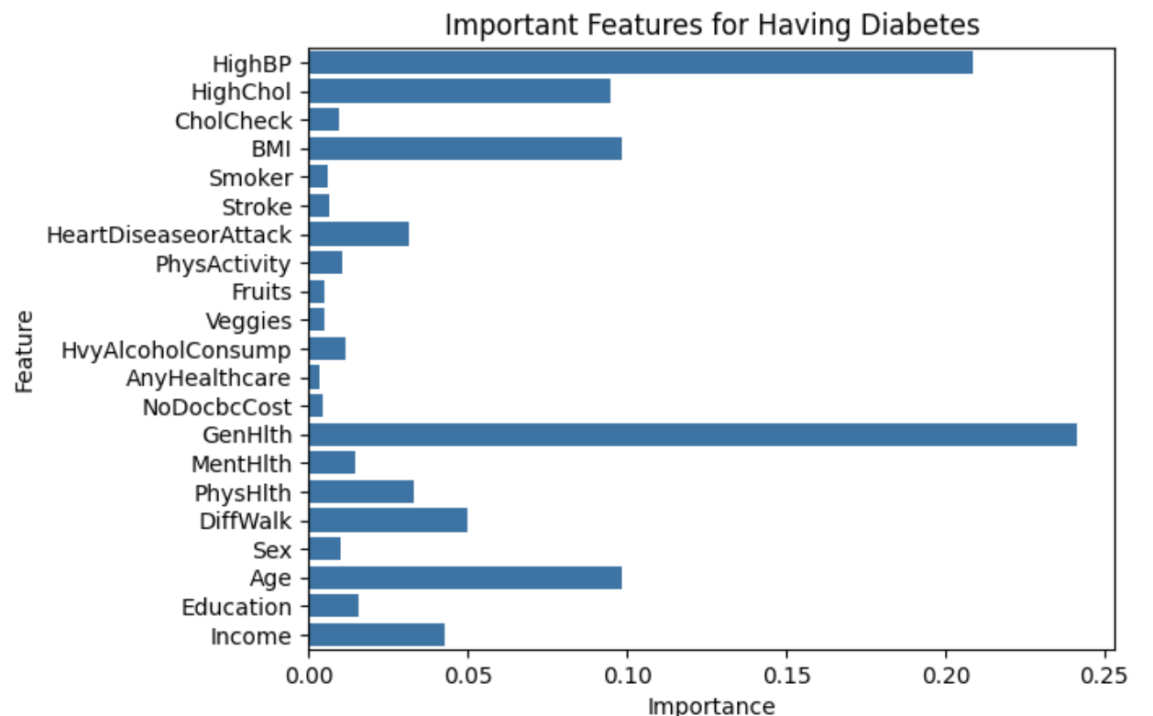
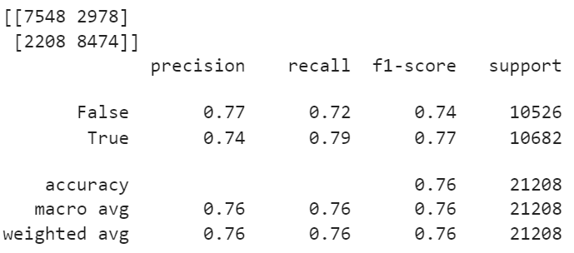
Model Overview – Random Forest
Dataset:
The dataset contained features relevant to diabetes diagnosis and a binary target indicating the presence or absence of diabetes.
Preprocessing:
Categorized BMI 0: <=18, 1: 19-24, 2: 25-29, 3: 30-39, 4: 40+ according to CDC guidelines
Model Evaluation:
Was evaluated with num_estimators=100 and max_depth=10 to shorten computational time and costs
Performance Metrics:
Model performance was evaluated using accuracy score on the test set.
Results
The highest accuracy was achieved at random state=13, with a score of 75.59%
Indicates most important features for having prediabetes or diabetes are: GenHlth, HighBP, Age, BMI, and HighChol

Slide 14
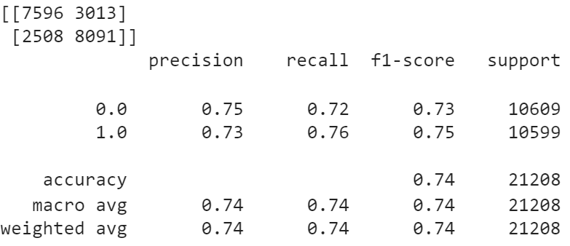
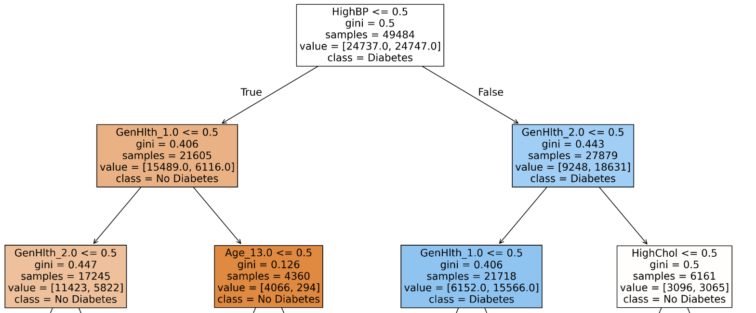
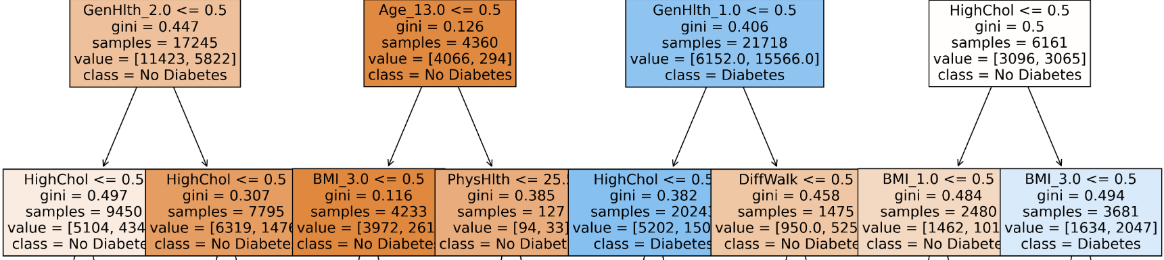
Model Overview – Decision Tree
Dataset:
The dataset contained features relevant to diabetes diagnosis and a binary target indicating the presence or absence of diabetes.
Preprocessing:
Categorized BMI 0: <=18, 1: 19-24, 2: 25-29, 3: 30-39, 4: 40+ according to CDC guidelines
One-hot encoded categorical values GenHlth, Age, Education, BMI and Income
Model Evaluation:
Was evaluated with criterion=gini and max_depth=10 to shorten computational time and costs
Performance Metrics:
Model performance was evaluated with an accuracy score on the test set.
Results
The highest accuracy was achieved at random state=35, with a score of 73.97%
Tree is displayed with a max_depth=3 to focus on top 3 levels which holds the most importance
Tree predicts those who do not have HighBP, likely to also not have diabetes even with low GenHlth, and high Age, BMI and HighChol
While those who do have HighBP are likely to not have Diabetes if low BMI and do not have trouble walking

Slide 15
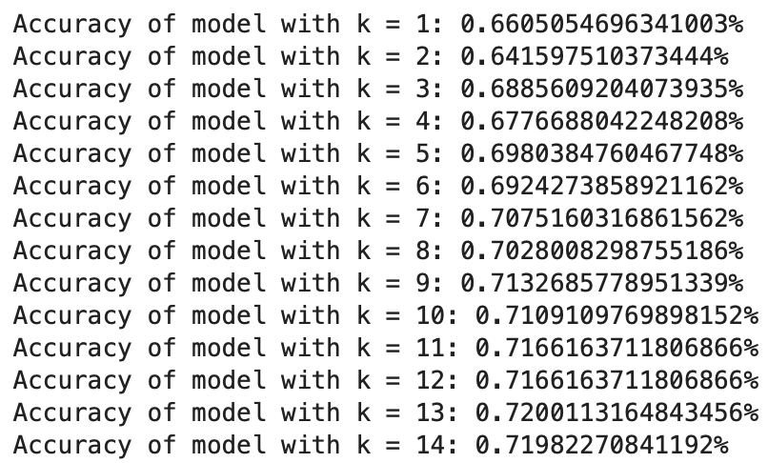
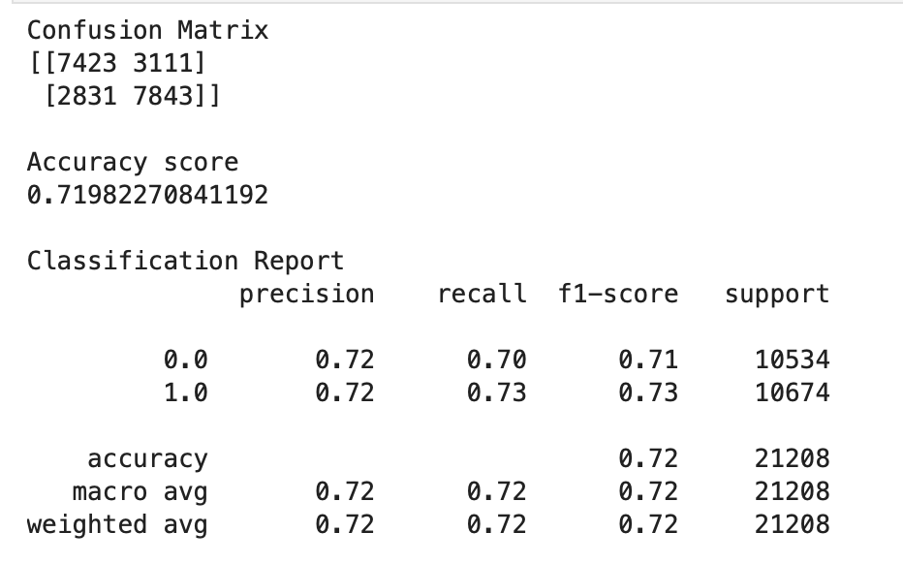
Model Overview – K Nearest Neighbour
Dataset:
The dataset contained features relevant to diabetes diagnosis and a binary target indicating the presence or absence of diabetes.
Model Evaluation:
The KNN algorithm was tested for K values ranging from 1 to 14.
Two distance metrics were used:
Euclidean Distance: Measures straight-line distance between points.
Manhattan Distance: Measures distance as the sum of absolute differences in each dimension.
Performance Metrics:
Model performance was evaluated using accuracy score on the test set.
Results
The highest accuracy was achieved at k=13, with a score of 72%.
Euclidean Distance outperformed Manhattan Distance consistently across all k values.
Performance comparison revealed that Euclidean Distance provided better generalization for this dataset, likely due to its sensitivity to overall feature magnitude.

Slide 16
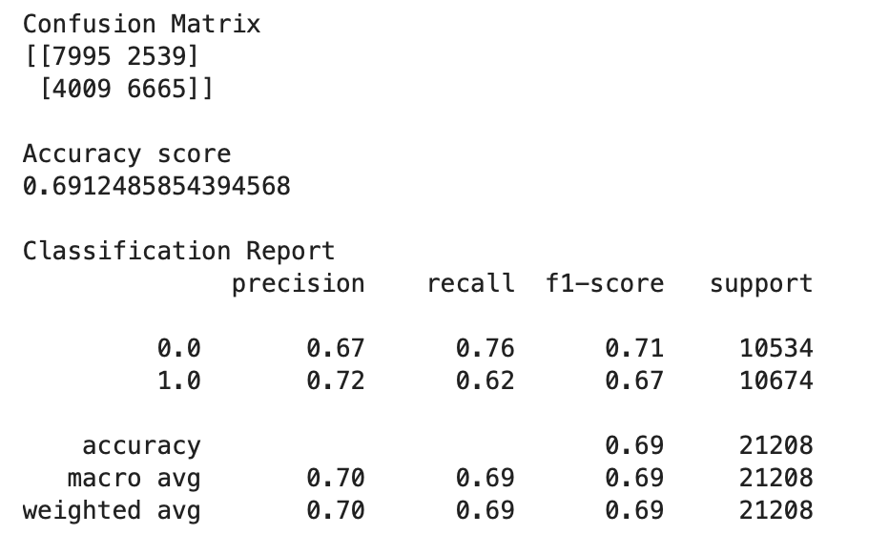
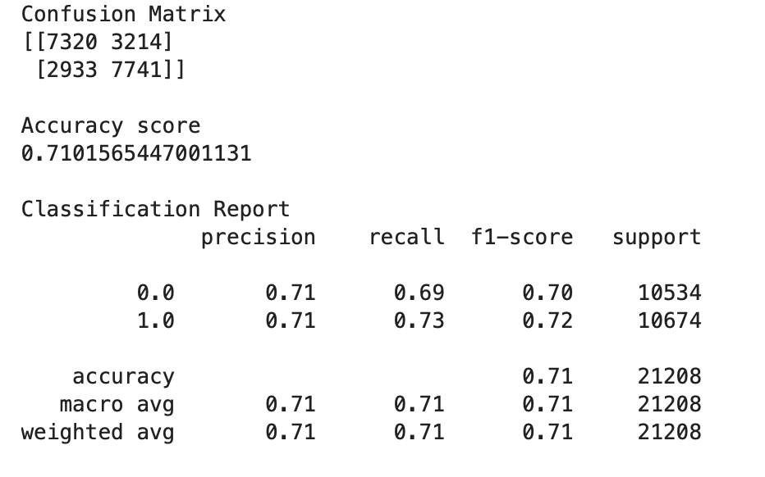
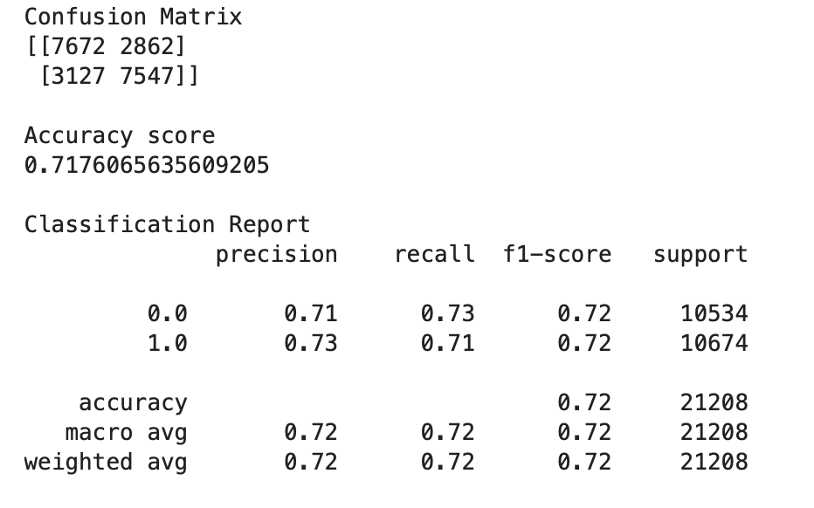
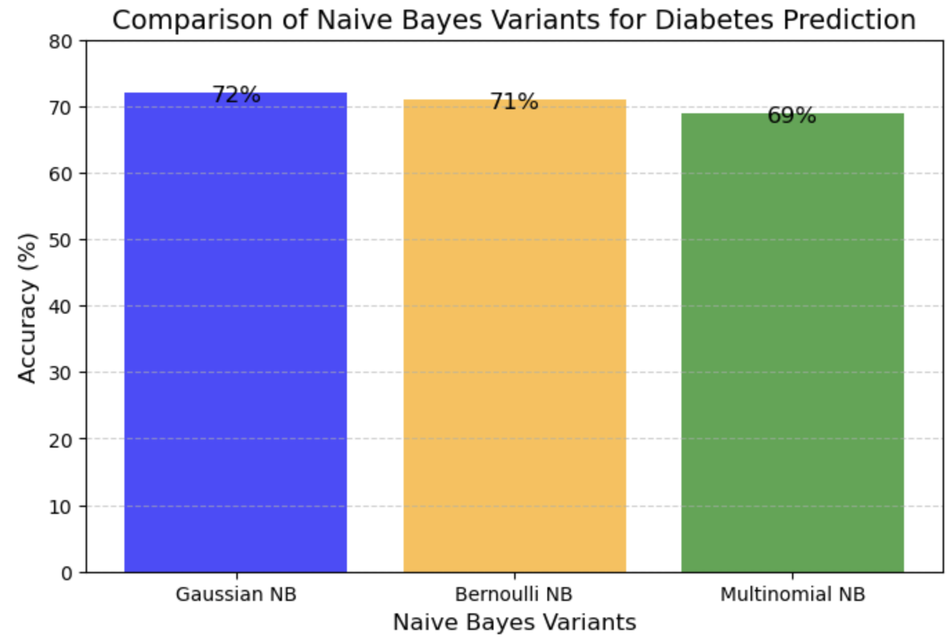
Model Overview - Naïve Bayes
MultiNomial NB
Bernoulli NB
Dataset:
The dataset included features relevant to diabetes diagnosis and a binary target indicating the presence or absence of diabetes.
Appropriate preprocessing was applied, ensuring compatibility with each Naive Bayes variant.
Algorithm Variants:
Gaussian NB: Assumes features are normally distributed.
Multinomial NB: Designed for discrete counts, suitable for text data but adapted for this analysis.
Bernoulli NB: Suitable for binary features, modeling the presence or absence of features.
Model Evaluation:
Each variant was tested using the same dataset and evaluated using accuracy score on the test set.
Results
Gaussian NB: Achieved the highest accuracy of 72%, leveraging its assumption of normally distributed features.
Bernoulli NB: Performed slightly lower at 71%, benefiting from binary feature modeling.
Multinomial NB: Scored 69%, as its assumption of discrete counts was less aligned with the dataset characteristics.
Gaussian NB

Slide 17
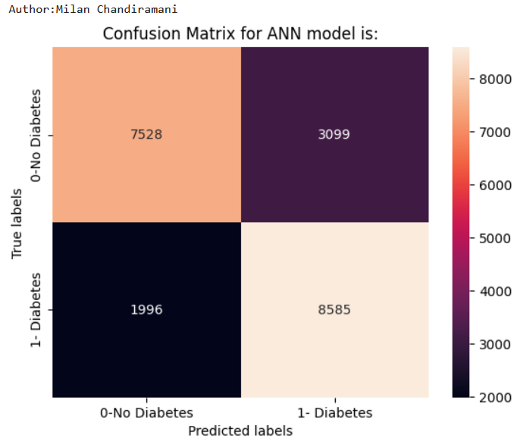
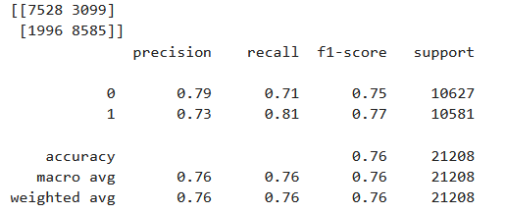
Model Overview – Artificial Neural Network (ANN)
Preprocessing:
Ensured all categorical parameters are encoded using label encoders
Did extensive tuning by:
Creating models of different neurons within 1 hidden layer (Accuracy peaked to ~74%, with a precision of ~78%)
Creating models with a combination of neurons embedded along 2 hidden layers
Model regularized through dropout
Model Evaluation:
Best model based on accuracy is achieved with 2 hidden layers of 28 and 14 neurons respectively.
Was evaluated with hyperparameters:
dropout_rate = 0.1, epochs = 11
batch_size = 32, learn_rate = 0.001
Performance Metrics:
Model performance was evaluated using accuracy score on the test set.
Results
The highest accuracy was achieved at random state=57, with a score of 75.98%
A strong precision of 81% is achieved.

Slide 18
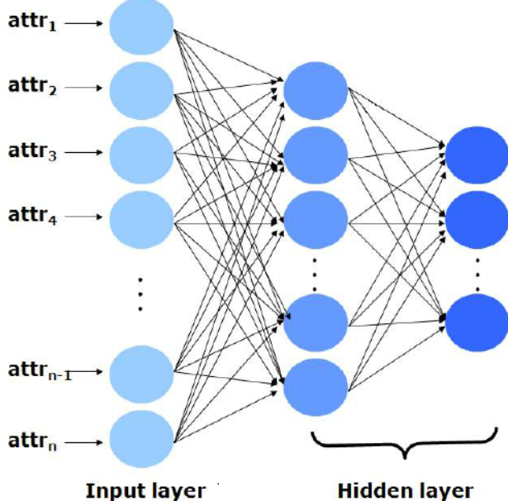
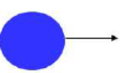

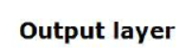
Model Overview – Artificial Neural Network (ANN)
Input Layer:
21 parameters
Hidden Layer 1: 28 neurons, ReLU
Hidden Layer 2: 14 neurons, ReLU
Output Layer: 1 neuron, sigmoid

Slide 19
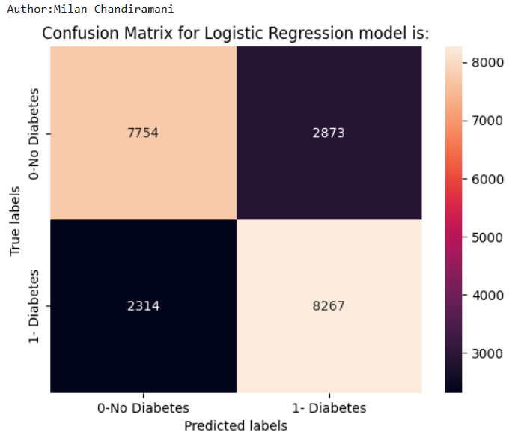
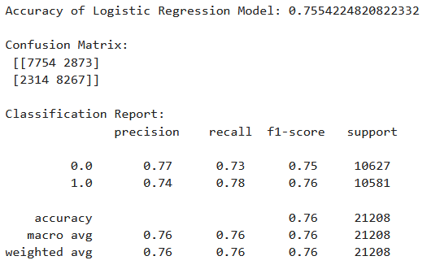
Model Overview – Logistic Regression
About Model
Logistic regression is a supervised machine learning algorithm used for both classification and regression tasks. In classification, the goal is to predict the probability that an instance belongs to a given class or not.
Model Evaluation:
Binary Classifier
L2 penalty is used for model training and evaluation.
Performance Metrics:
Model performance was evaluated using accuracy score on the test set.
Results
The highest accuracy was achieved at random state=57, with a score of 75.54%

Slide 20
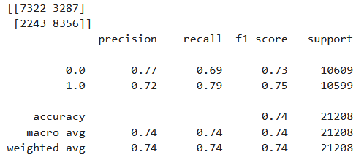
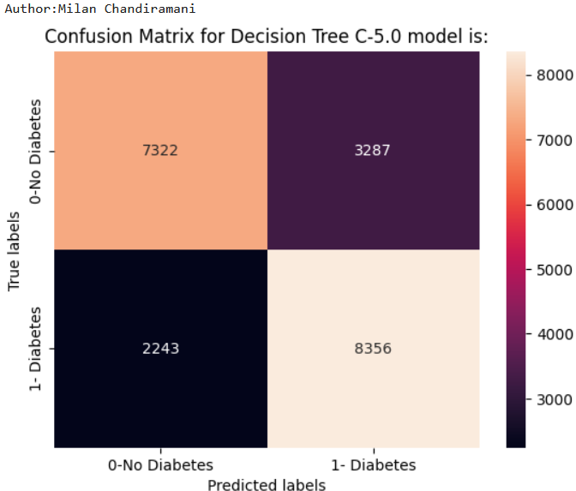
Model Overview – Decision Tree C-5.0
Preprocessing:
Categorized BMI 0: <=18, 1: 19-24, 2: 25-29, 3: 30-39, 4: 40+ according to CDC guidelines
One-hot encoded categorical values General Health, Age, Education, BMI and Income
Top 15 Params: 'HighBP', 'HighChol', 'BMI', 'Smoker', 'Stroke', 'HeartDiseaseorAttack', 'PhysActivity', 'NoDocbcCost', 'GenHlth', 'MentHlth', 'PhysHlth', 'DiffWalk', 'Age', 'Education', 'Income'
Model Evaluation:
Was evaluated with criterion=entropy and max_depth=9 to shorten computational time and costs
Performance Metrics:
Model performance was evaluated with an accuracy score on the test set.
Results:
The highest accuracy was achieved at random state=35, with a score of 73.93% considering 15 most relevant parameters, and a score of 73.96% considering all input parameters.
It is very interesting that consumption of fruits and veggies have much less correlation with a person having Diabetes.
Tree in the following page predicts those who do not have High Blood Pressure, likely to also not have diabetes even with low General Health, and high Age, BMI and High Cholesterol
While those who do have High Blood Pressure are likely to not have Diabetes if low BMI and also don't have High Cholesterol.

Slide 21
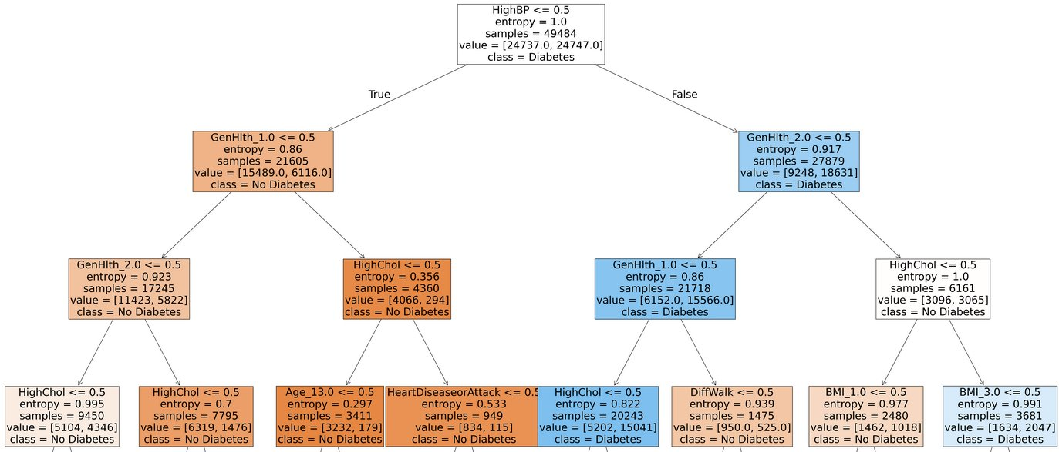
Model Overview – Decision Tree C-5.0

Slide 22
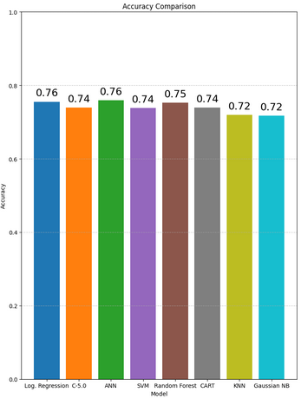
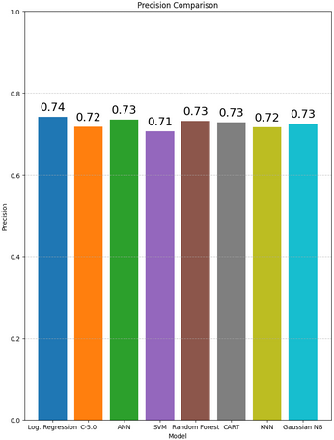
Comparison & Conclusions – Accuracy and Precision (1 of 3)

Slide 23
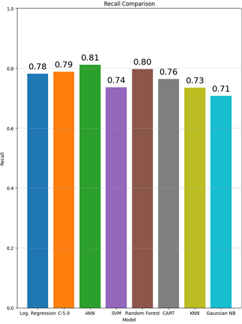
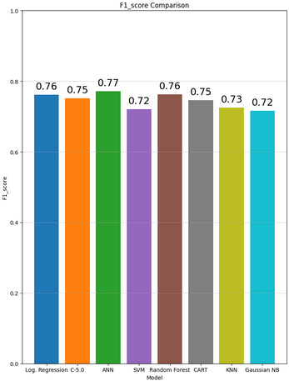
Comparison & Conclusions - Recall and F1 Score (2 of 3)

Slide 24
Comparison & Conclusions (3 of 3)
K-means (Un-supervised algorithm) is not a great clustering algorithm due to overlap present within data grouping.
Both Logistic Regression and ANN (2 hidden layer) models performs relatively similar in terms of accuracy (~0.76 ), followed by Random Forest model (~0.75).
The ANN model has the highest recall (~0.811), which indicates it is most successful at identifying true positive cases of diabetes. This is followed by random forest (~0.79) and C50 decision tree (~0.788). Models like SVM (~0.736) and KNN (~0.735) show relatively lower recall.
Logistic Regression has the highest precision (~0.74) and also performs strongly in terms of F1-score (~0.76). However, the ANN model, with a slightly lower precision (~0.73), still maintains a solid F1-score (~0.77). The C50 decision tree model shows slightly weaker precision (~0.718) but performs reasonably well on F1-score (~0.75).

Slide 25
Future Work
Hyper Parameter Tuning,
Model Deployment in Cloud/POC on Streamlit
Use the latest surveyed data,
Use the other supported datasets,
Implement advanced clustering algorithms,

Slide 26
References
https://www.kaggle.com/code/haidar14/ml-diabetesdatasetclustering
https://www.kaggle.com/datasets/alexteboul/diabetes-health-indicators-dataset/data
Diabetes Prediction Using Random Forest (Random Forest for Diabetes Classification) https://www.sciencedirect.com/science/article/abs/pii/S1877050919302763
A Hybrid Model of CART and Genetic Algorithm for Diabetes Diagnosis ( CART (Classification and Regression Trees) for Diabetes Classification) Link: https://journals.sagepub.com/doi/full/10.1177/2158244013490703
Application of Decision Tree Classifier in Prediction of Diabetes (Decision Tree Classifier for Diabetes Classification) https://pubmed.ncbi.nlm.nih.gov/28714436/
Application of Artificial Neural Networks for Diabetes Classification: A Review (Artificial Neural Network (ANN) for Diabetes Classification) https://www.ncbi.nlm.nih.gov/pmc/articles/PMC4211254/
Predicting Diabetes Using XGBoost Model (XGBoost for Diabetes Classification) https://www.sciencedirect.com/science/article/pii/S2352914819302171
A SVM-based Diabetes Prediction Model Using Ensemble Classifiers (Support Vector Machines (SVM) for Diabetes Classification) https://pubmed.ncbi.nlm.nih.gov/32714468/
K-means Clustering with Random Forest Classifier for Diabetes Diagnosis (K-means Clustering for Diabetes Classification) https://www.sciencedirect.com/science/article/pii/S2352914819303062
K-Nearest Neighbors Classifier for Early Diabetes Detection (K-Nearest Neighbors (KNN) for Diabetes Classification) https://www.hindawi.com/journals/jchem/2020/6535434/
Diabetes Prediction Using Naive Bayes and Logistic Regression (Multinomial Naive Bayes for Diabetes Classification) https://www.hindawi.com/journals/complexity/2021/6647793/
Adult BMI Categories https://www.cdc.gov/bmi/adult-calculator/bmi-categories.html

Slide 28


Questions?

Slide 29
Data Fields
AnyHealthcare | Have any king of healthcare coverage 0 = No 1 = Yes
NoDocbcCost | Any time in past 12 months needed a doctor but could not go because of cost? 0 = No 1 = Yes
GenHlth | Would you say that in general your health is: 1 = Excellent 2 = Very Good 3 = Good 4 = Fair 5 = Poor
MentHlth | Days of Poor Mental Health 1-30 days
PhysHlth | Physical Illness or Injury In Past 30 days 1-30 days
DiffWalk | Have serious difficulty walking or climbing stairs 0 = No 1 = Yes
Sex | 0 = Female 1 = Male
Age | Scale 1-13 1 = 18-24 Increments every 5 years 13 = 80+
Education | Highest Grade or Year of School Completed 1 = Never Attended / Only Kindergarten 2 = Elementary 3 = Some Highschool 4 = Graduated Highschool 5 = Some College 6 = Graduated College
Income | Scale 1-8 Increment every $5k 1 = less than $10,000 5 = $20,000 - $35,000 8 = $75,000+
Diabetes_binary | 0 = No Diabetes 1 = Prediabtes & diabetes
HighBP | 0 = No High Blood Pressure 1 = High Blood Pressure
HighChol | 0 = No High Cholesterol 1 = High Cholesterol
CholCheck | 0 = No Cholesterol Check in 5 years 1 = Yes Cholesterol Check in 5 years
BMI | Body Mass Index
Smoker | Have smoked 100 cigarettes in entire life? 0 = No 1 = Yes
Stroke | Ever Told You Had a Stroke? 0 = No 1 = Yes
HeartDiseaseorAttack | 0 = No 1 = Yes
PhysActivity | Physical Activity in Past 30 Days (not including job) 0 = No 1 = Yes
Fruits | Consumed Fruit 1 or More Times Per Day 0 = No 1 = Yes
Veggies | Consumed Vegetables 1 or More Times Per Day 0 = No 1 = Yes
HvyAlcoholConsump | Adult Men >= 14 drinks per week Adult Women >= 7 drinks per week 0 = No 1 = Yes
Notes:
Aryan

